Slide 1
CalSTRS and Your Retirement

Slide 2
What brings you to CalSTRS today?

Slide 3
Today’s Discussion
The CalSTRS Hybrid
Retirement Estimates
Providing for Loved Ones
Defined Benefit Supplement Account
Social Security and CalSTRS
Steps Toward Retirement
CalSTRS Resources

Slide 4
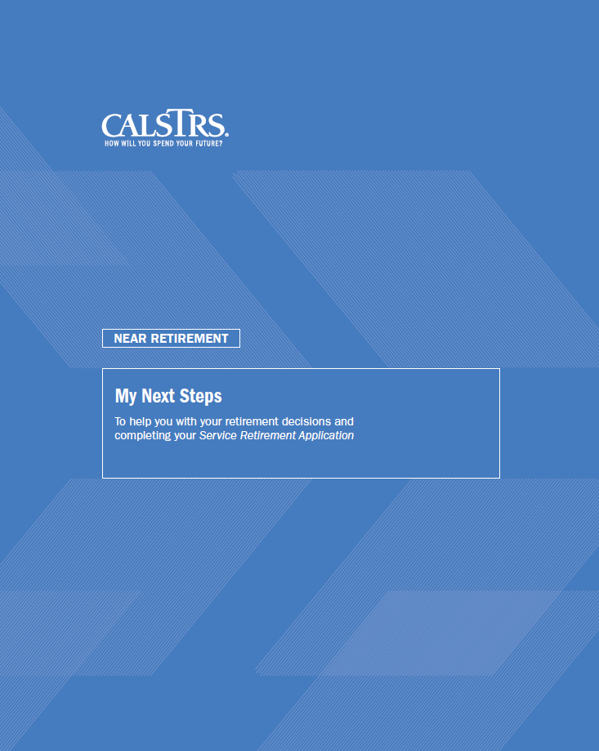
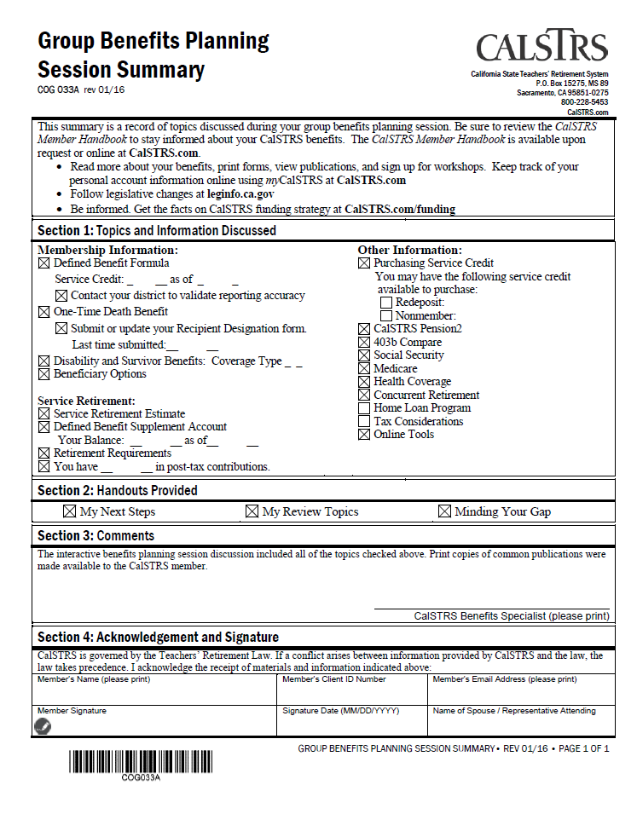
Today’s Tools
My Next Steps:
Interactive workbook
Guide for today’s session
Action items
Session Summary:
Your personal information
Refer to throughout the session
Overview of
today’s topics

Slide 5
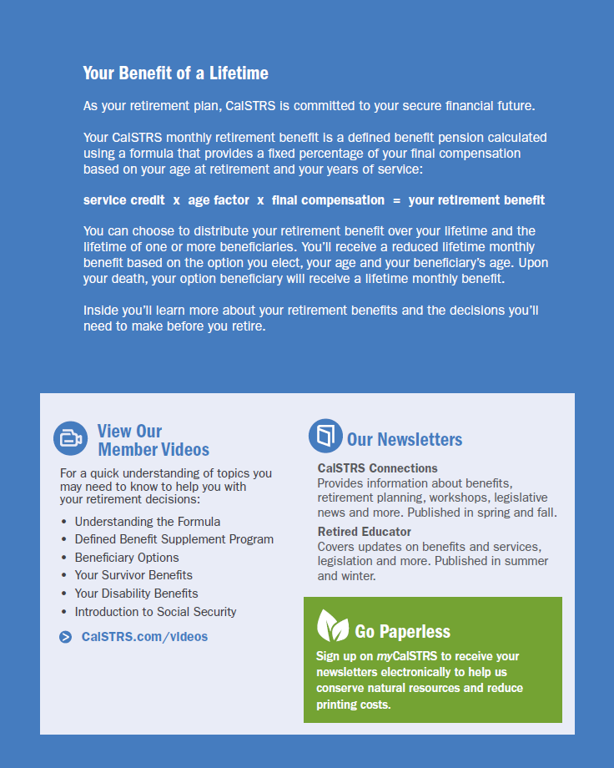
My Next Steps

Slide 6
Did you know CalSTRS is a hybrid retirement system?

Slide 7
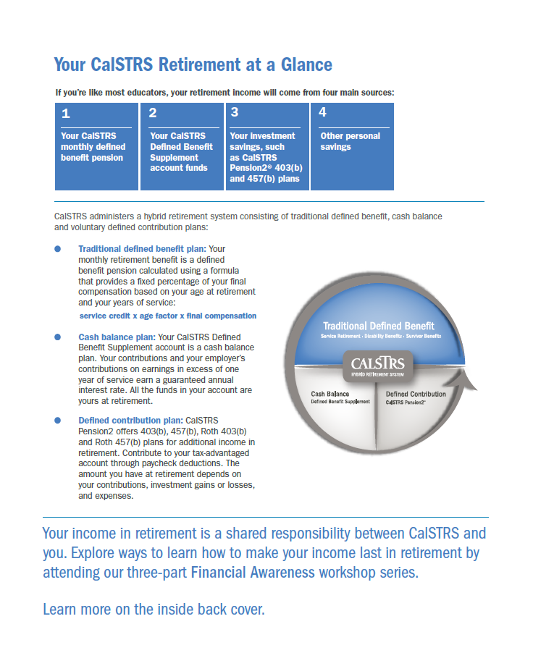
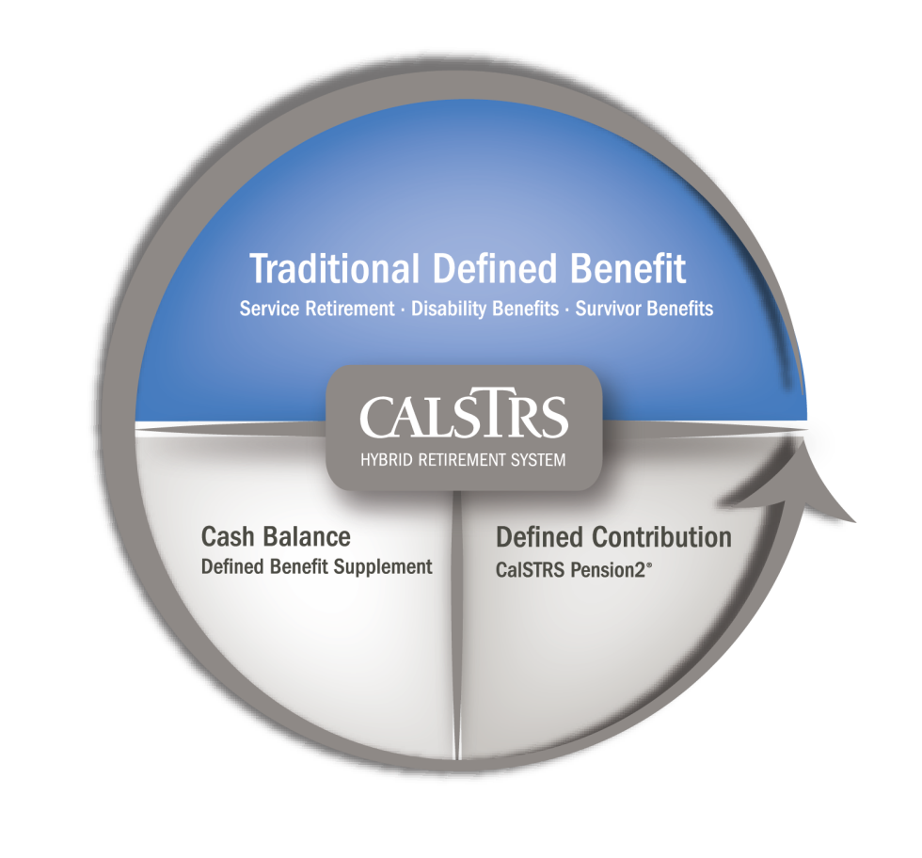
Your CalSTRS Retirement at a Glance
Traditional Defined Benefit
Defined Benefit Supplement
Defined Contribution
Notes:
Refer to the DB program, DBS and Pension2 as the three parts of CalSTRS Hybrid Retirement System
Please note:
• Refer members to Your CalSTRS Retirement at a Glance page of the My Next Steps.
• Refer to hybrid components as a transition from DB, DBS, and P2.

Slide 8
Section 1 My Member Information

Slide 9
Section 1: My Member Information

Slide 10
Section 2 My Defined Benefit Retirement

Slide 11
How much is my Defined Benefit retirement?

Slide 12
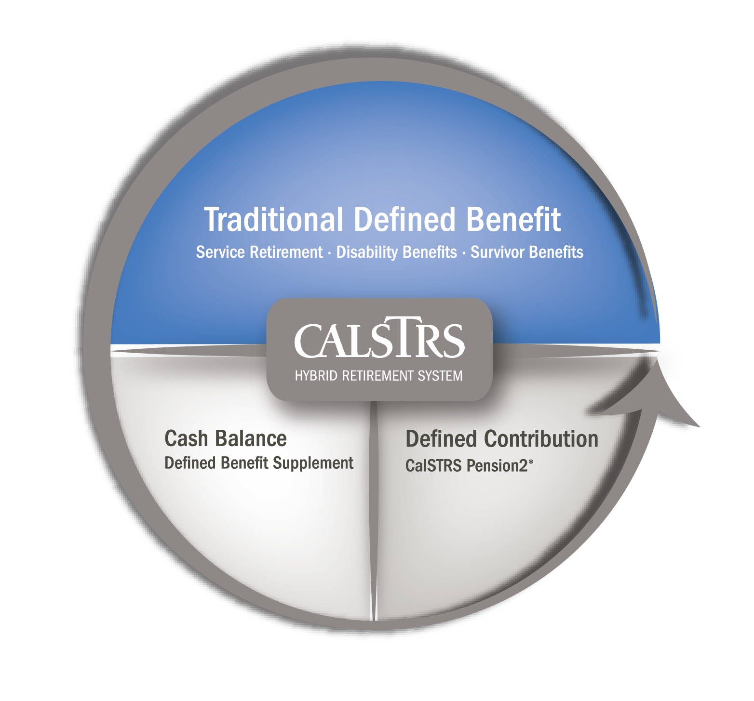

Slide 13
Defined Benefit Retirement Formula
*
*Taxable income

Slide 14
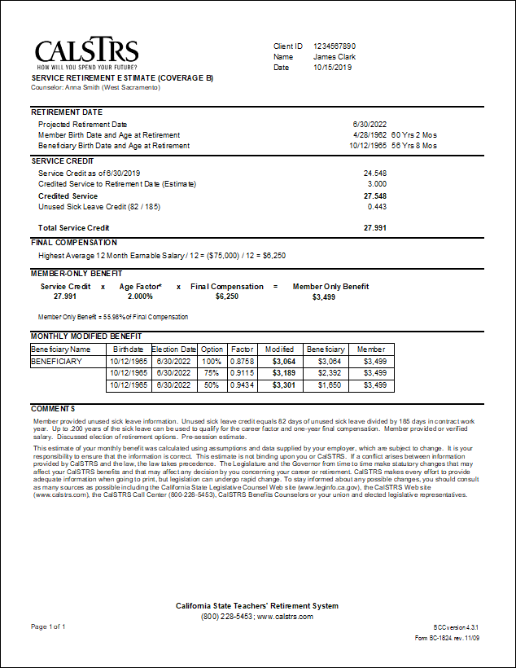
My Retirement Estimate
For 2% at 60 members, if you retire with 30 or more years of credited service, 0.20% will be added to your age factor, up to 2.40%.
Notes:
Review estimate.
Point out that the highest average 12 month earnable salary is used in this estimate because the member is under the 2% @ 60 benefit structure and has over 25 years of credited service.
Mention that the Career Factor benefit enhancement is only available for 2% @ 60 members.

Slide 15
Section 2: My Defined Benefit Retirement

Slide 16
Can I provide a lifetime benefit to my loved ones after my death?

Slide 17
Beneficiary Options

Slide 18
Providing for My Loved Ones

Slide 19
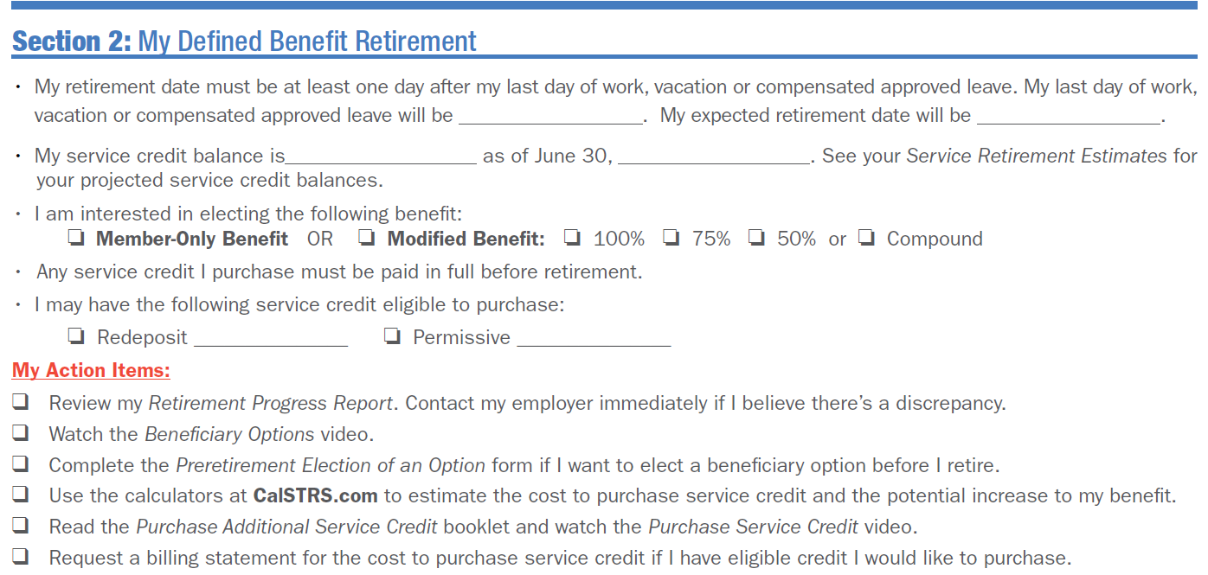
Section 2: My Defined Benefit Retirement

Slide 20
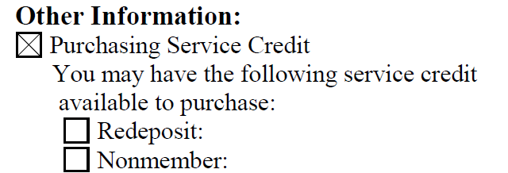
Purchasing Service Credit
You may be able to:
Redeposit withdrawn contributions
Purchase permissive service credit

Slide 21
Purchasing Service Credit
Notes:
Point out Our Publications page in My Next Steps and explain that the most popular CalSTRS publications are listed here (and can be accessed using a QR code scanner) or online at CalSTRS.com.
For all other forms and publications, encourage member to download materials from CalSTRS.com or submit information through myCalSTRS.

Slide 22
Purchasing Service Credit

Slide 23
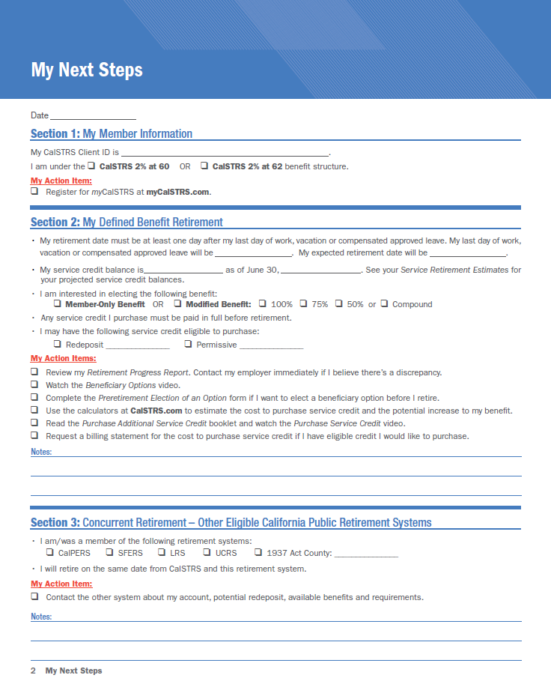
Section 2: My Defined Benefit Retirement

Slide 24
Section 3 Concurrent Retirement

Slide 25
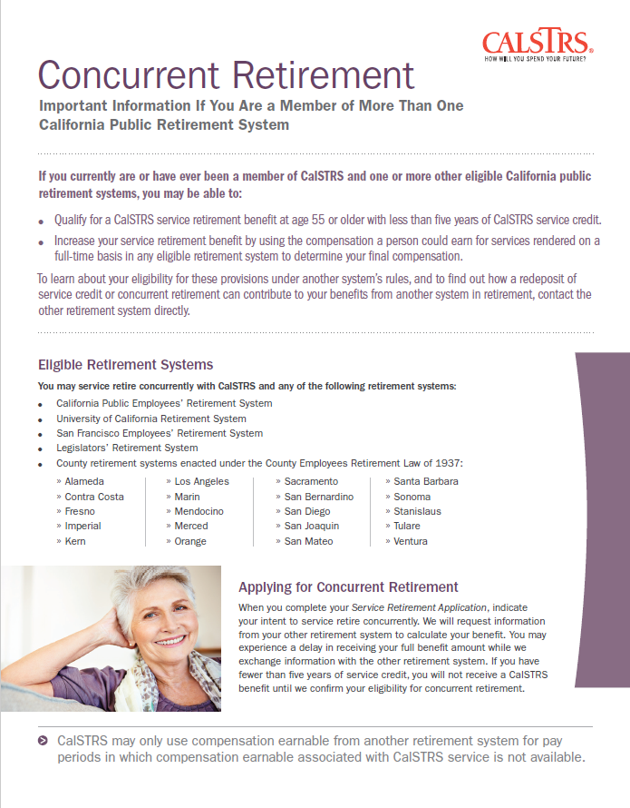
Section 3: Concurrent Retirement

Slide 26
Section 4 My Defined Benefit Supplement Account

Slide 27
What is the Defined Benefit Supplement account?

Slide 29
Section 4: My Defined Benefit Supplement Account
For your Defined Benefit Supplement account balance, refer to your Session Summary.

Slide 30
Section 4: My Defined Benefit Supplement Account
Lump-sum payment
Direct payment* or rollover
Period-Certain Annuity
3 to 9 year*
10 year
Account balance of $3,500 or more
Lifetime Annuity
Member-Only or Beneficiary Annuity
Combination
Lump-sum payment and annuity*
*Tax considerations

Slide 31
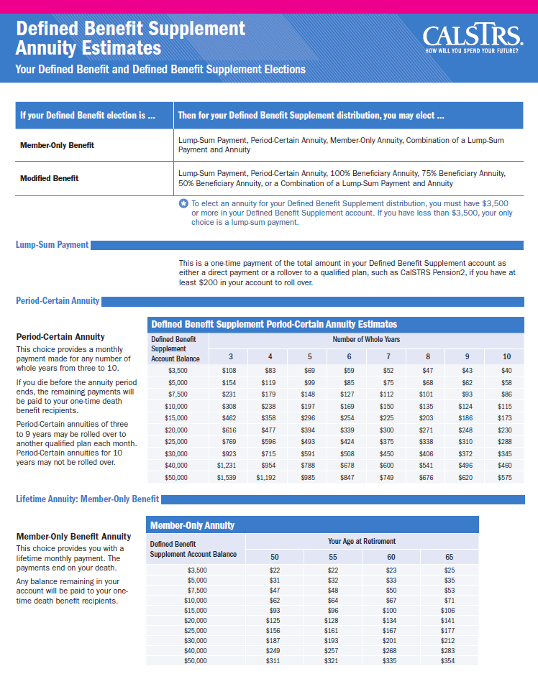
Section 4: My Defined Benefit Supplement Account
Account balance under $3,500
or
more than 1 year from retirement

Slide 32
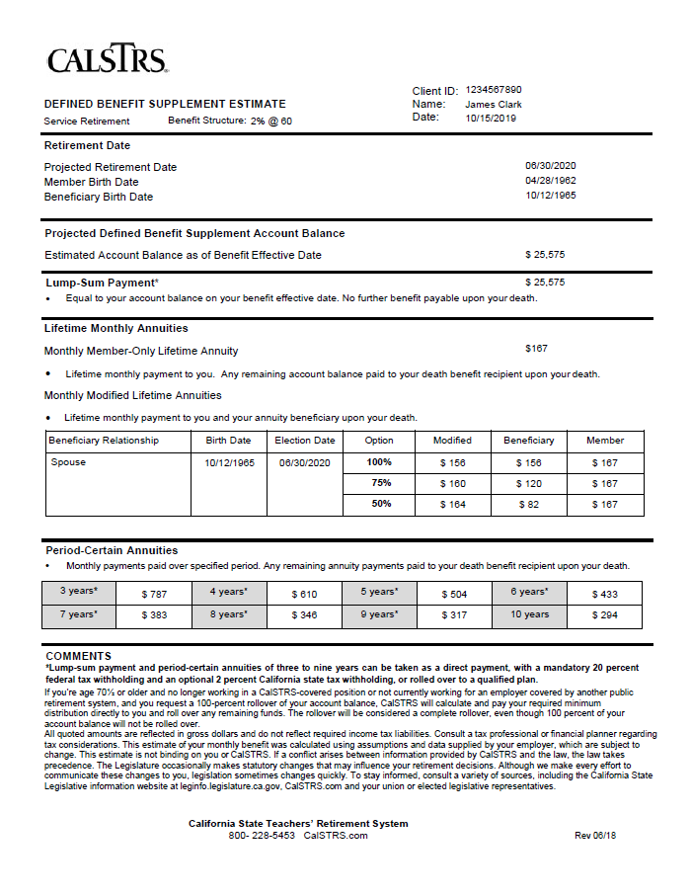
Section 4: My Defined Benefit Supplement Account
Account balance of $3,500 or more
and
within 1 year of retirement

Slide 33
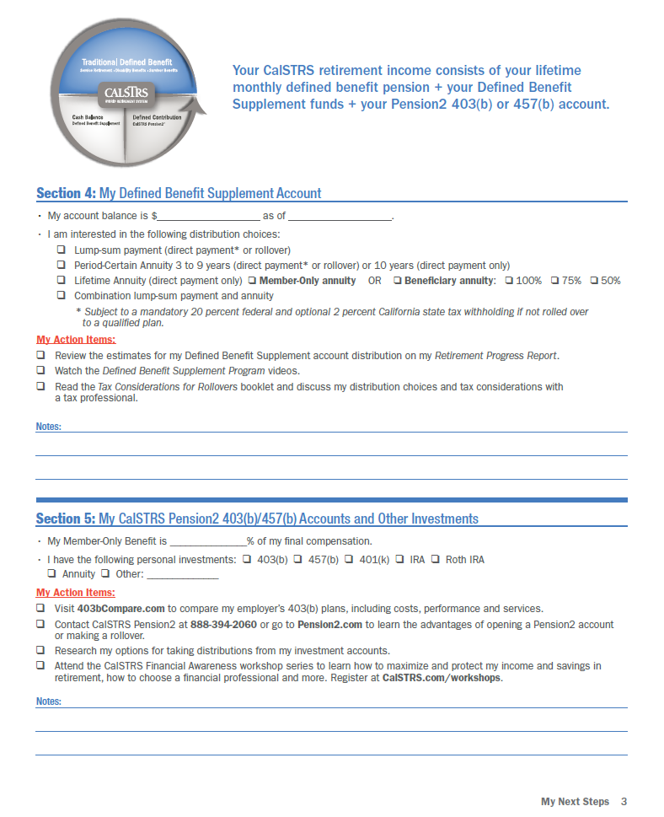
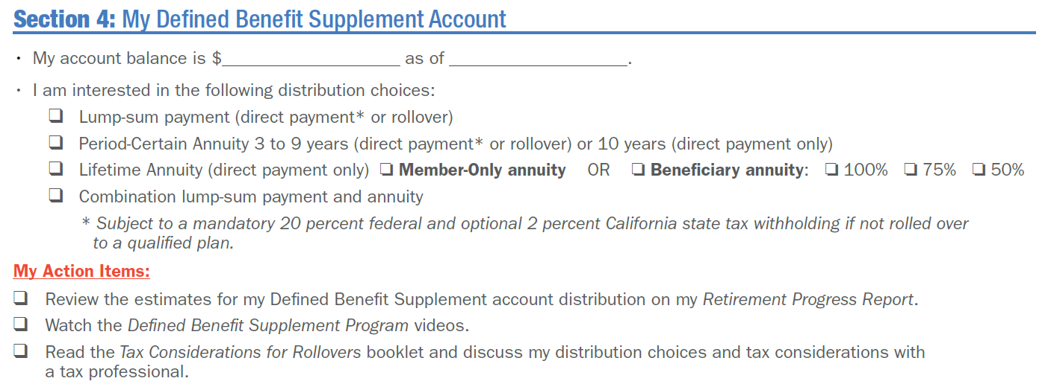
Section 4: My Defined Benefit Supplement Account

Slide 34
Section 5 My CalSTRS Pension2 Account and Other Investments

Slide 36
Do I have enough to retire?

Slide 37
Section 5: My CalSTRS Pension2 Account and Other Investments
Refer to your Defined Benefit estimate for your percentage.

Slide 38
CalSTRS Pension2
Tax-deferred
retirement savings
Low and transparent costs
No commissions, load fees or surrender charges
Flexible investment options
For a complimentary statement comparison, call 888-394-2060, option 2.

Slide 39
What else does CalSTRS provide?

Slide 40
Section 6 My Disability and Survivor Benefits

Slide 41
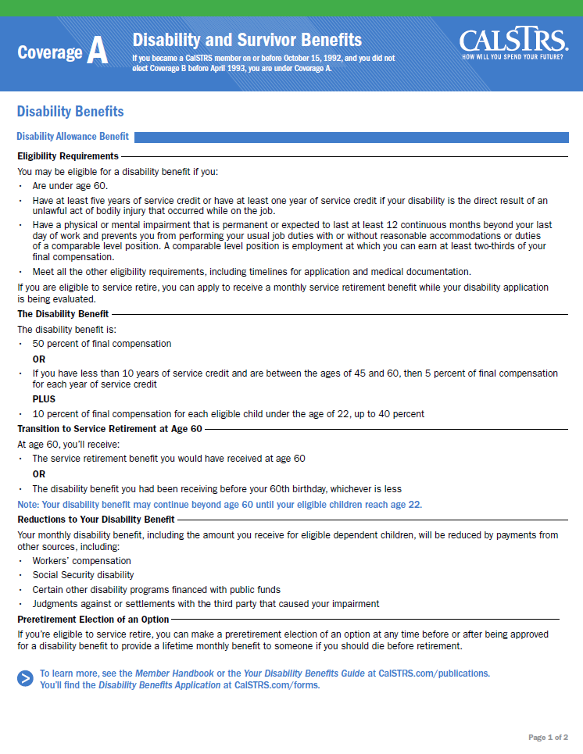
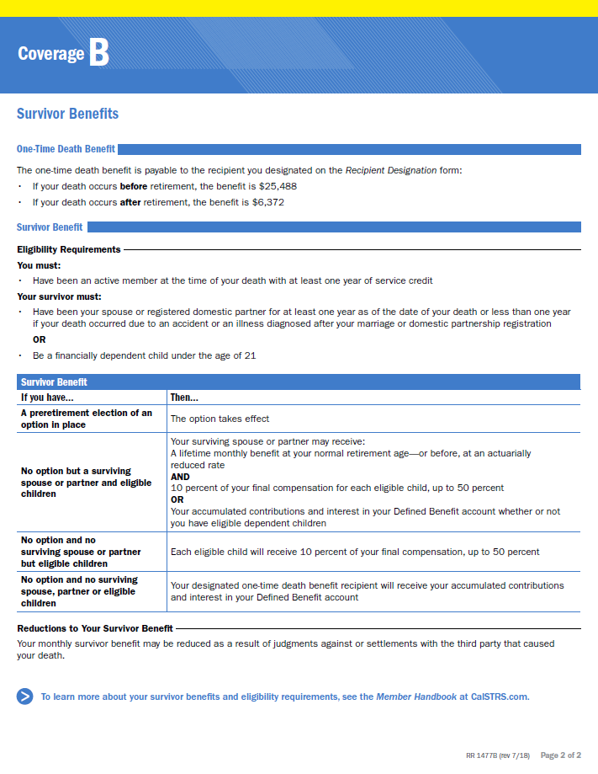
Disability and Survivor Benefits

Slide 42
One-Time Death Benefit
For your recipient designation information, refer to your Session Summary.

Slide 43
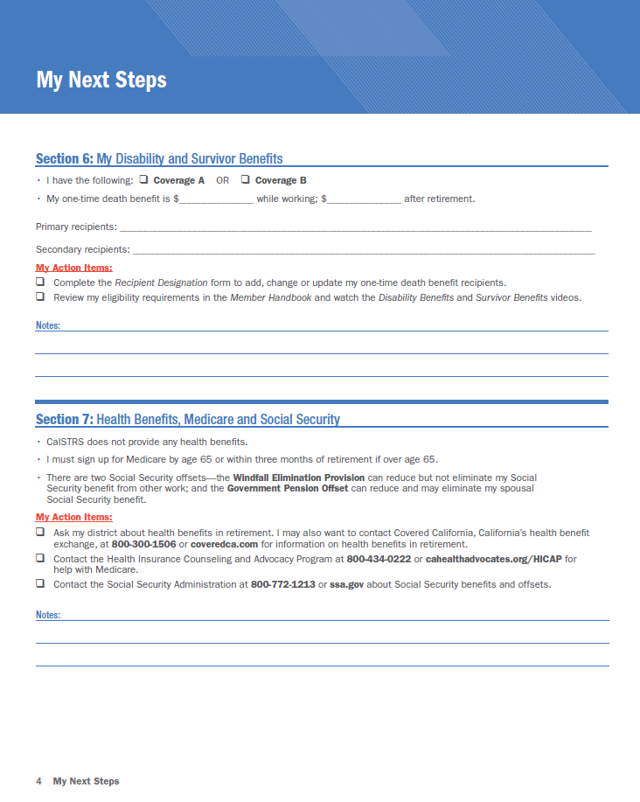
Section 6: My Disability and Survivor Benefits

Slide 44
Section 7 Health Benefits, Medicare and Social Security

Slide 45
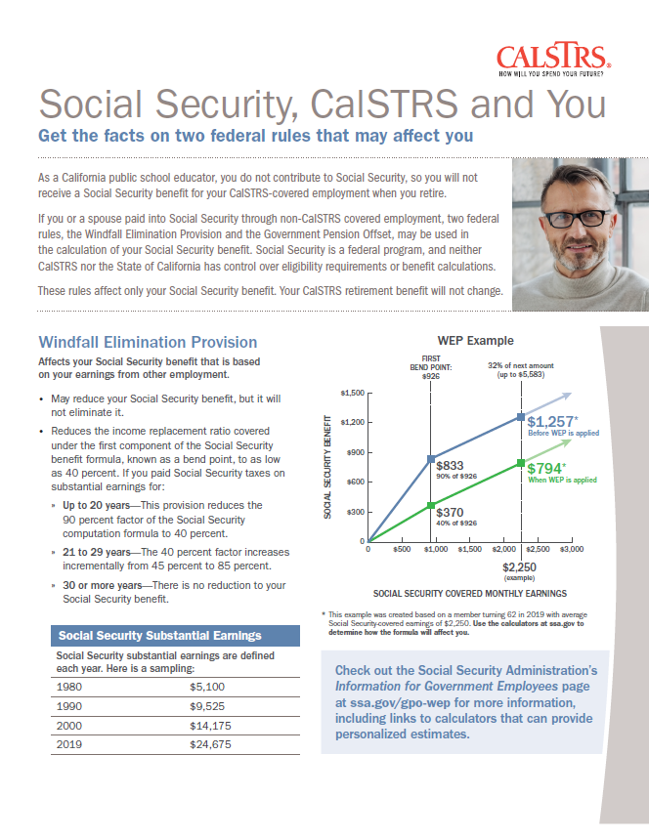
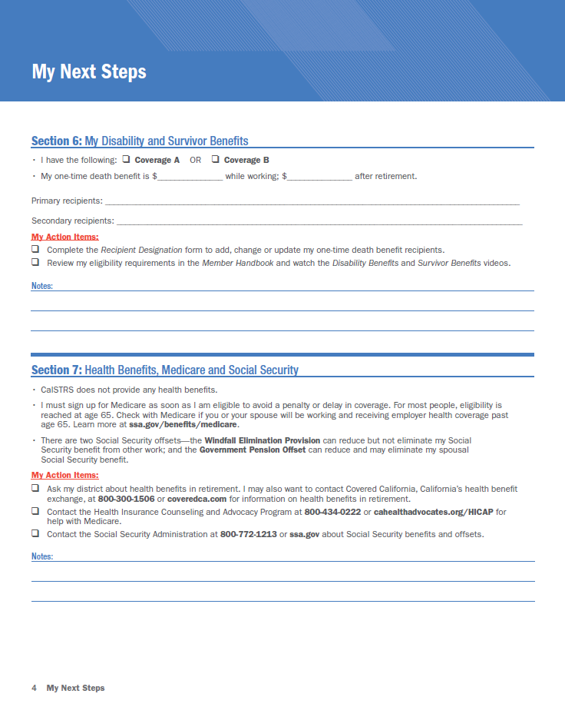
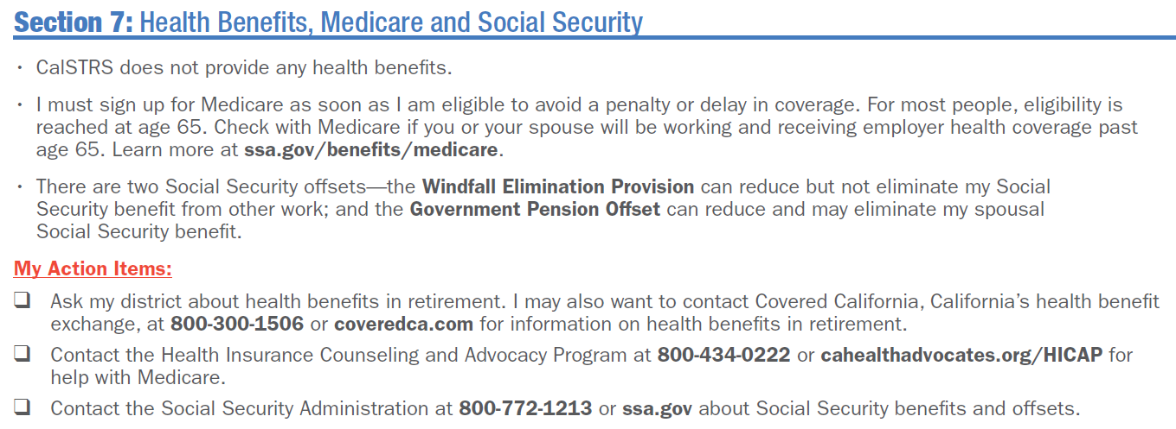
Section 7: Health Benefits, Medicare and Social Security

Slide 46
What do I need to do to retire?

Slide 47
Section 8 My Service Retirement Application and Benefit Payments

Slide 48
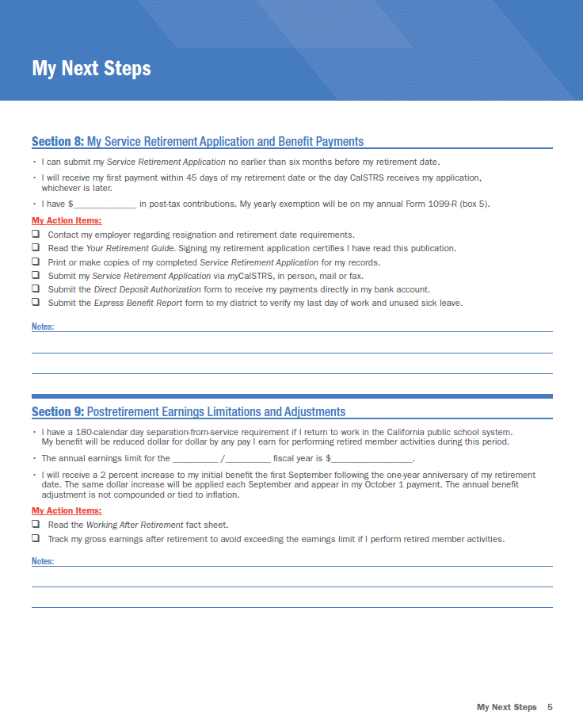
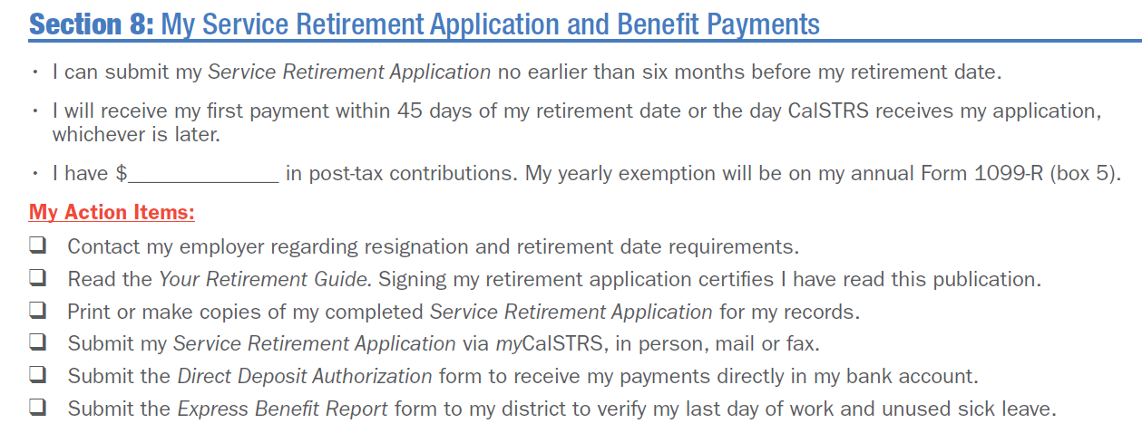
Section 8: My Service Retirement Application and Benefit Payments

Slide 49
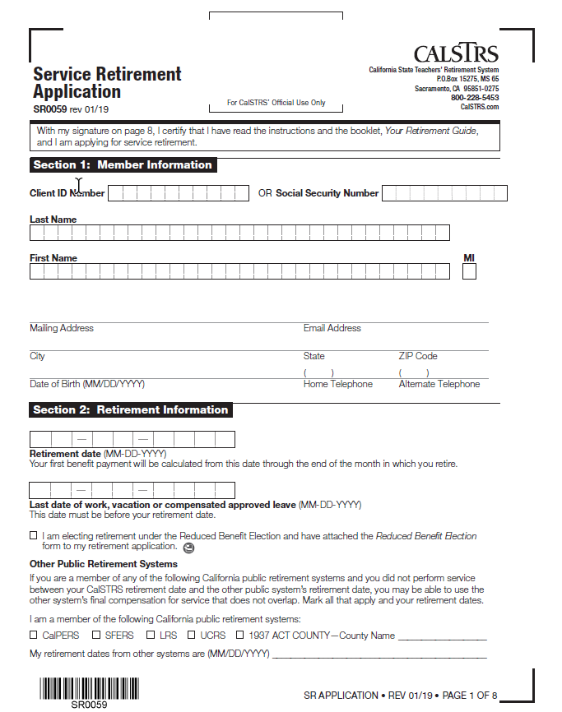
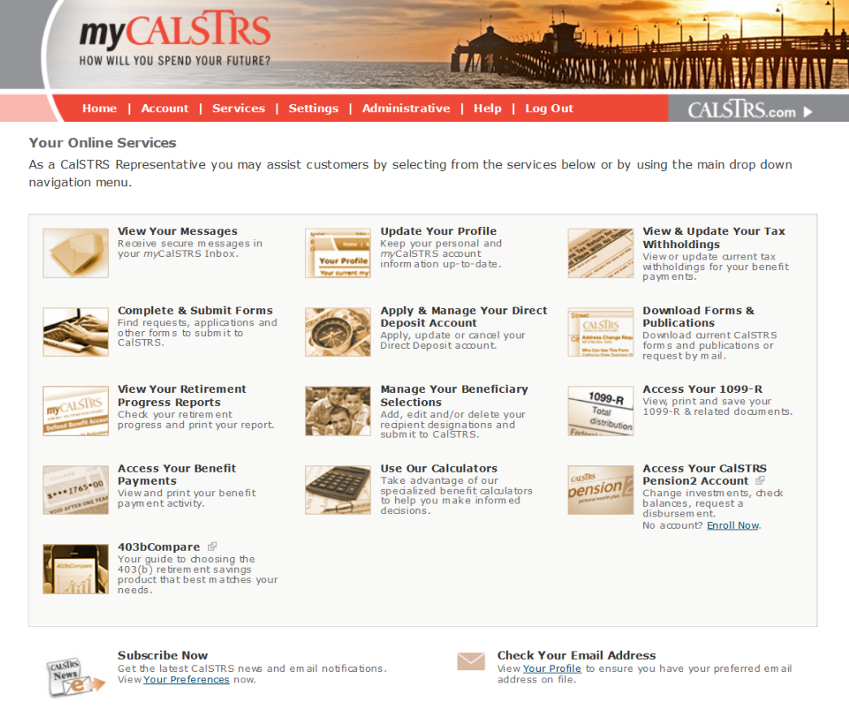
Submit My Service Retirement Application

Slide 50
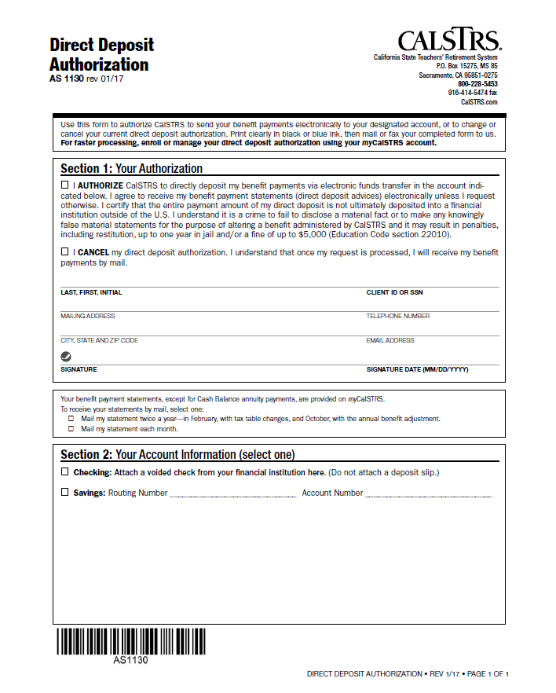
Sign Up for Direct Deposit

Slide 51
Submit an Express Benefit Report
Submit to all employers within the last year
Verifies:
Unused sick leave days
Last day of work

Slide 52
What happens once I retire?

Slide 53
Section 9 Postretirement Earnings Limitations and Adjustments

Slide 54
Section 9: Postretirement Earnings Limitations and Adjustments
2020−21 fiscal year earnings limit = $47,713

Slide 55
What are my CalSTRS resources?

Slide 56
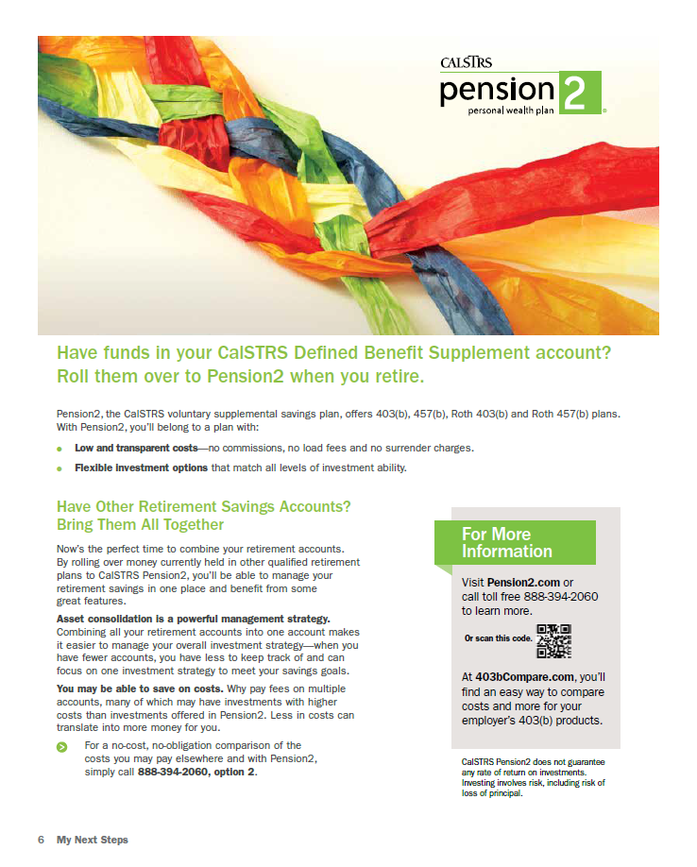
My Next Steps

Slide 57
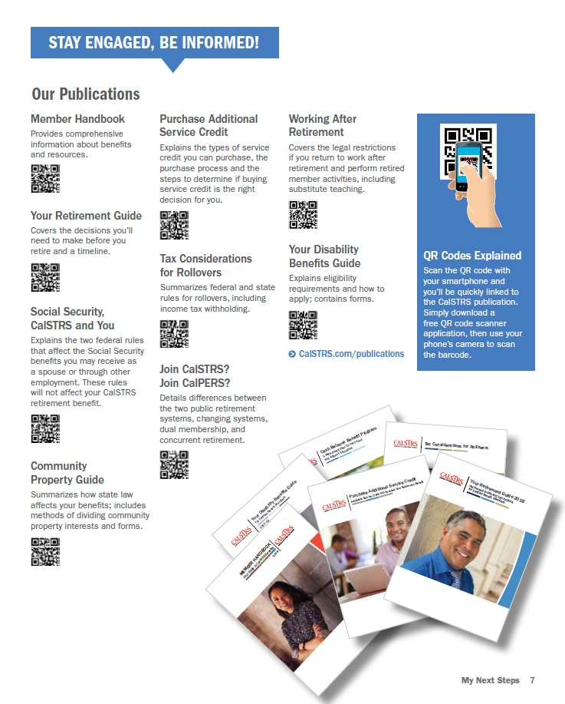
CalSTRS Publications

Slide 58
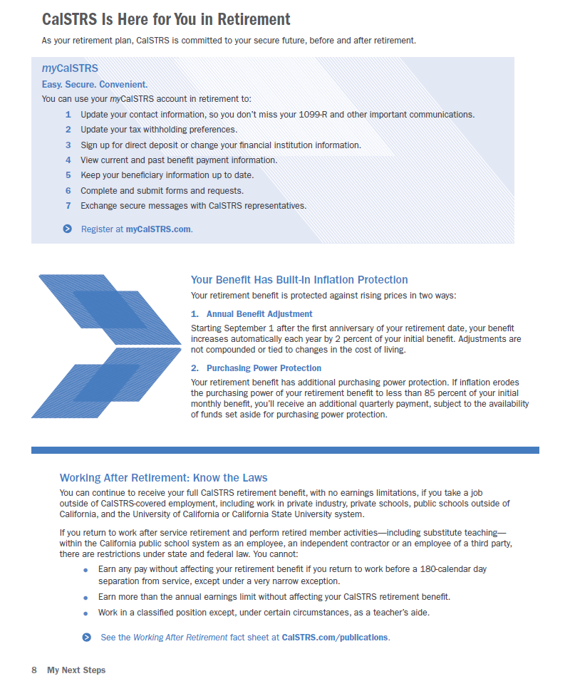
My Next Steps

Slide 59
Workshops
Financial Awareness Series
Budgeting, savings and investing, credit and debt
Plan for Your Future
Retirement lifestyle, expenses, income, obstacles
Protect Your Future
Retirement distributions, maximizing income, adjustments, protection
Save for Your Future

Slide 60
myCalSTRS
Secure messaging
Address changes
Beneficiary elections
Tax withholding changes
Retirement Progress Report

Slide 61
Retirement Progress Report
Service credit
Account balances
Retirement estimates
Beneficiary information

Slide 62
CalSTRS.com
Calculators
Forms and publications
Educational videos
Financial resources

Slide 63
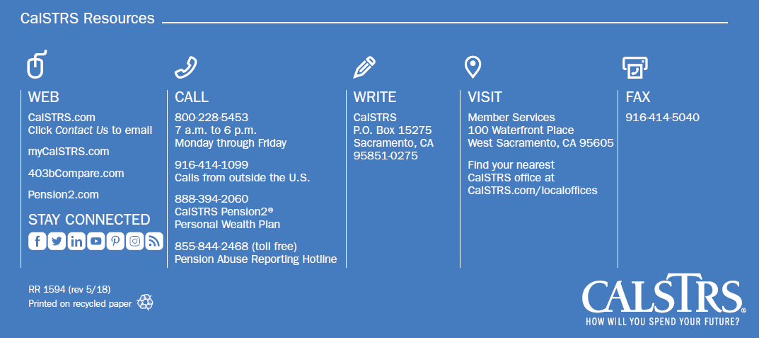
Contact CalSTRS

Slide 64
Thank you for attending

